Slide 1
Drivers Impacting the Lubricant Industry
Afton Chemical
Phil Ames
March 2013

Slide 2
Topics
Market Drivers
  Energy consumption trends
  Government regulations
How Can the Lubricant Industry Help?
  Commercial vehicles
  Passenger cars
  Industrial

Slide 3
Market Drivers

Slide 4
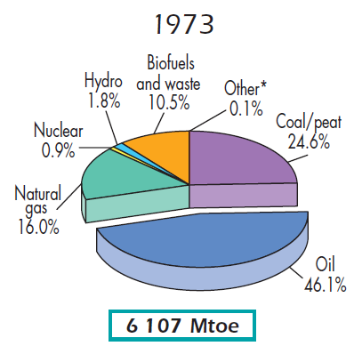
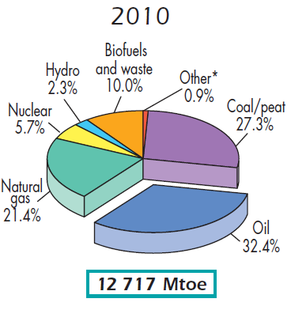
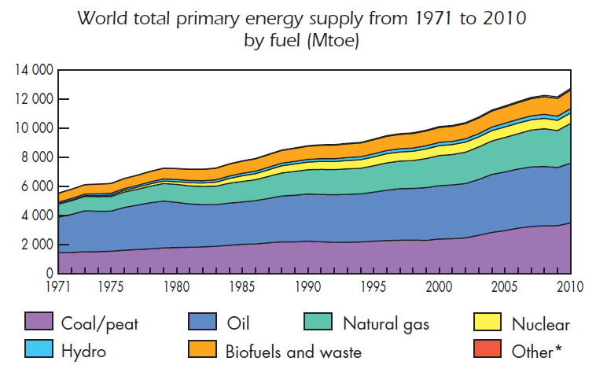
Global Energy Consumption Trends
Total fossil fuel from 87% to 81%
Mainly lost share to nuclear
Petroleum derivatives remain the most important sector for consumption
2012 © Afton Chemical Corporation, All Rights Reserved. Not to be copied, shared, or reproduced in any media without the express written permission of Afton Chemical Corporation.

Slide 5






Global Energy Consumption Issues
Finite amount of fossil fuel
Health effects
Climate change
Consumer impacts
Are drivers for change
Government regulation
Energy conservation
Alternative energy sources

Slide 6
Key Drivers - Regulations
Government Fuel Economy & Emission Mandates
Changes in Equipment Design & Hardware
Changes in Fuels & Lubricants

Slide 7
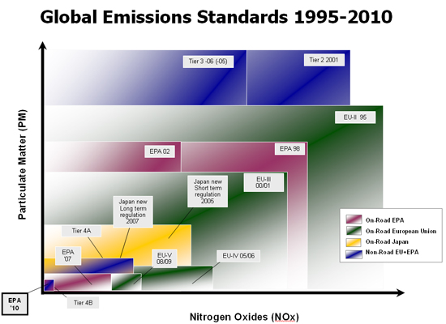

Commercial Vehicle Key Drivers - Regulations
Legacy Regulations
New Regulations

Slide 8
Commercial Vehicle Key Drivers - Regulations
MY 2017 Combination Tractor Standards
 | EPA Emission Standards (max. grams CO₂ / ton-mile) |  |  | NHTSA Fuel Consumption Standards (max. gallons / 1,000 ton-mile)
 | Low Roof | Mid Roof | High Roof | Low Roof | Mid Roof | High Roof
Day Cab Class 7 | 104 | 115 | 120 | 10.2 | 11.3 | 11.8
Day Cab Class 8 | 80 | 86 | 89 | 7.8 | 8.4 | 8.7
Sleeper Class 8 | 66 | 73 | 72 | 6.5 | 7.2 | 7.1
Engine Standards for Tractor Installations
Engine Type | Year | CO2 Emissions (grams / bhp-hr) | Fuel Consumption (gallons / 100 bhp-hr)
MHD Engines | 2014 (voluntary) | 502 | 4.93
 | 2017 | 487 | 4.78
HHD Engines | 2014 (voluntary) | 475 | 4.67
 | 2017 | 460 | 4.52

Slide 9
PC-11: The Next Generation
Expected First Licensing Date January 1, 2016
  Driven by changes in engine technology to meet emissions, renewable and fuel economy standards to meet CO2 and other GHG emissions
  Engine Test Obsolescence (Hardware Becoming Unavailable)
Two separate and distinct sub-categories:
  Higher HTHS (15w-40, 3.5 HTHS) – Preserves historical HD viscosity limits and backwards compatibility
  Lower HTHS (10w-30, 3.0 HTHS) – Provides fuel efficiency benefits while maintaining equivalent durability
    Manufacturers will determine applicability and backwards compatibility
Overall, PC-11 will have similar tests to CJ-4, but will define a higher performance oil for conventional grades and introduce low HTHS heavy-duty oils for fuel economy
2012 © Afton Chemical Corporation, All Rights Reserved. Not to be copied, shared, or reproduced in any media without the express written permission of Afton Chemical Corporation.

Slide 10
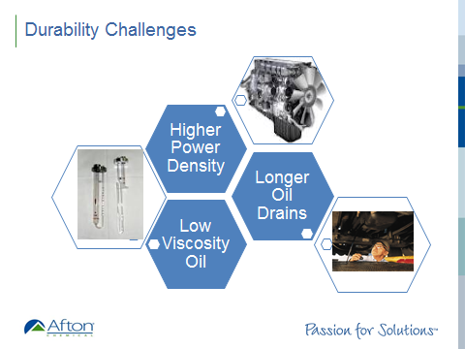

PC-11: Effects on Engine Oil Requirements
Fuel economy
Long oil drains
Oxidation stability
Aeration control
Shear stability
Biodiesel compatibility
Wear protection
5 new tests requested
  Mack T-13 Wear/Oxidation Test
  DDC/Daimler Scuffing Test
  CAT C-13 Aeration Test
  Oxidation Test
  Shear Stability Test

Slide 11
The #1 Driver for NA PCMO
Coordinated EPA Greenhouse Gas Standards
~ 163 grams per mile of CO₂ in 2025
52.5 mpg
~ 250 grams per mile of CO₂ in 2017
35.5 mpg
Fleet average is ~340 grams per mile of CO₂ today (29.7mpg in 2012)
Source: NHTSA.gov

Slide 12
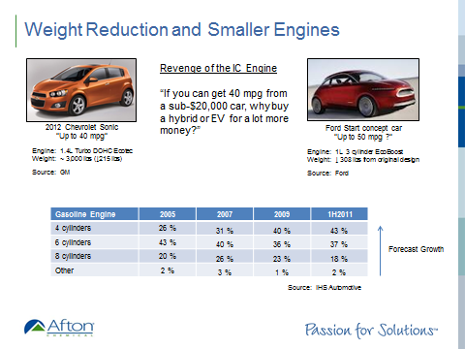
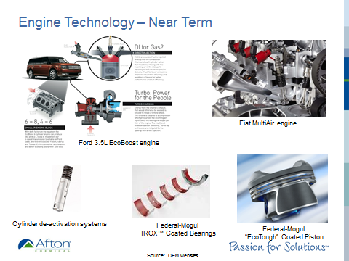
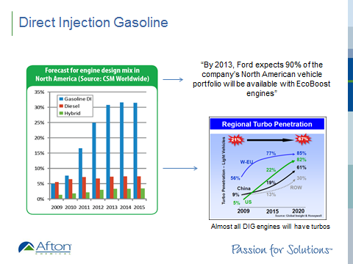
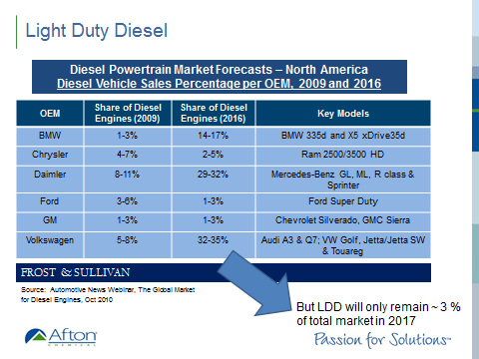
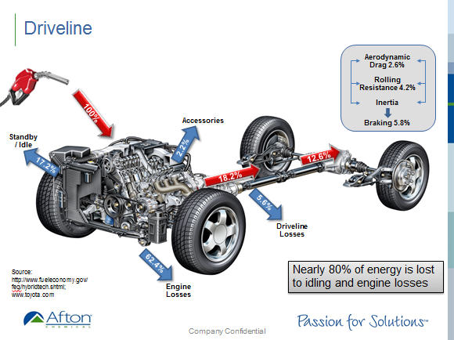
General Passenger Car Trend Summary
Engines will get smaller & more efficient
Engines will be more flexible in operation for better overall fuel efficiency
Direct injection gasoline designs will become more common
  >30% of market by 2015
Light duty diesel use will increase but with minimal market impact projected
Transmissions will get smaller, lighter viscosity, dual clutch, more gears
Oils will have increased operational stress and longer application life
OEM’s will promote use of technology to improve combustion efficiency – and fuel economy – and expect advanced lubricant technology to ensure no warranty problems for these new designs

Slide 13
GF-6 Update
API First License Date – September 30, 2016
ILSAC GF-6 development has been initiated
  GF-6A for current ILSAC grades
  GF-6B for new low HTHS grades for Japanese engines (0W-16)
Draft specification highlights:
  Improved cleanliness (WPD improvement in Seq IIIG)
  Improved viscosity control (Pvis improvement in Seq IIIG)
  Significantly improved fuel economy performance (0.5% for each stage FEI)
  Several new performance requirements proposed:
    Timing chain wear, LSPI
Test developments underway:
  Sequence IIIH Oxidation – GM or Chrysler
  Sequence IVB Valvetrain Wear – Toyota
  Sequence VH Sludge & Timing Chain Wear – Ford
  Sequence VIE Fuel Economy – Surveillance Panel

Slide 14
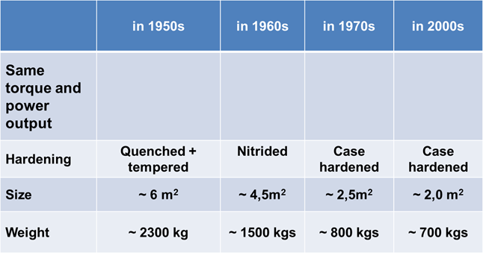





Industrial Trends
Courtesy of Siemens MD
Market Drivers
Tier 4 emission standards – driving hydraulic efficiency increases with mobile equipment OEMs
Equipment Impacts
More efficient pumps
Reduced size and weight of equipment
Extended drain intervals
Lubricant Enablers
More shear-stable VII’s for increased efficiency
Better seal compatibility at longer drain intervals
Higher oxidation stability
Better sludge and varnish control for gas turbines
Improved heat transfer formulation styles

Slide 15
Summary
Government regulations driving
  Emissions reductions
  Fuel economy improvements
  Efficiency improvements
Hardware operating conditions becoming more severe
  Smaller sumps
  Higher temperatures
  Higher loads
  Longer drain intervals
Lubricant industry must work closely with OEMs to evolve technologies to enable equipment changes

